Slide 1


Computer Number System
CSC 111- Introduction To Information & Communication Technologies
Lecture # 6
By
Aimen Sikander

Slide 2


NUMBER SYSTEM
CSC 111- Introduction To Information & Communication Technologies
Number systems are the technique to represent numbers in the computer system architecture, every value that you are saving or getting into/from computer memory has a defined number system.

Slide 3
Number System
CSC 111- Introduction To Information & Communication Technologies
When we type some letters or words, the computer translates them in numbers as computers can understand only numbers.
Computers store all data as binary digits, but we may need to convert this to a number system we are familiar with.

Slide 4
Number System
CSC 111- Introduction To Information & Communication Technologies
Computer architecture supports following number systems.
Binary number system
Octal number system
Decimal number system
Hexadecimal (hex) number system
Radix or base is the number of unique digits, including the digit zero, used to represent numbers.
Radix or Base = 0 to r-1 (where r is base/Radix)

Slide 5
Number System
CSC 111- Introduction To Information & Communication Technologies
Binary Number System
A Binary number system has only two digits that are 0 and 1.
Every number (value) represents with 0 and 1 in this number system.
The base of binary number system is 2, because it has only two digits.

Slide 6

Number System
CSC 111- Introduction To Information & Communication Technologies
Binary Number System
Each binary digit is also called a bit.
In any binary number, the rightmost digit is called least significant bit (LSB) and leftmost digit is called most significant bit (MSB).

Slide 7
Number System
CSC 111- Introduction To Information & Communication Technologies
Octal Number System
Octal number system has only eight (8) digits from 0 to 7.
Every number (value) represents with 0,1,2,3,4,5,6 and 7 in this number system.
The base of octal number system is 8, because it has only 8 digits.

Slide 8
Number System
CSC 111- Introduction To Information & Communication Technologies
Decimal Number System
Decimal number system has only ten (10) digits from 0 to 9.
Every number (value) represents with 0,1,2,3,4,5,6, 7,8 and 9 in this number system.
The base of decimal number system is 10, because it has only 10 digits.

Slide 9
Number System
CSC 111- Introduction To Information & Communication Technologies
Hexadecimal Number System
A Hexadecimal number system has sixteen (16) alphanumeric values from 0 to 9 and A to F.
Every number (value) represents with 0,1,2,3,4,5,6, 7,8,9,A,B,C,D,E and F in this number system.
The base of hexadecimal number system is 16, because it has 16 alphanumeric values.
Here A is 10, B is 11, C is 12, D is 13, E is 14 and F is 15.

Slide 10
Number System
CSC 111- Introduction To Information & Communication Technologies
Number System | Base(Radix) | Used Digits | Example
Binary Number System | 2 | 0,1 | (11110000)₂
Octal Number System | 8 | 0,1,2,3,4,5,6,7 | (360)₈
Decimal Number System | 10 | 0,1,2,3,4,5,6,7,8,9 | (2480)₁₀
Hexa-decimal Number System | 16 | 0,1,2,3,4,5,6,7,8,9,A,B,C,D,E,F, | (F0)₁₆

Slide 11
Computer - Number Conversion
CSC 111- Introduction To Information & Communication Technologies
There are many methods or techniques which can be used to convert numbers from one base to another. we'll demonstrate the following.
Decimal to Other Base System
Other Base System to Non-Decimal
Shortcut method - Octal to Binary
Shortcut method - Hexadecimal to Binary
Other Base System to Decimal
Shortcut method - Binary to Octal
Shortcut method - Binary to Hexadecimal

Slide 12
Computer - Number Conversion
CSC 111- Introduction To Information & Communication Technologies
Binary System to Decimal
Example - Binary Number: 10101₂ (Calculating Decimal Equivalent)
Note − 101012 is normally written as 10101.
Step | Binary Number | Decimal Number
Step 1 | 10101₂ | ((1 x 2⁴) + (0 x 2³) + (1 x 2²) + (0x 2¹) + (1 x 2⁰)) ₁₀
Step 2 | 10101₂ | (16 + 0 + 4 + 0 + 1) ₁₀
Step 3 | 10101₂ | 21₁₀

Slide 13
Computer - Number Conversion
CSC 111- Introduction To Information & Communication Technologies
Octal System to Decimal
Calculating Decimal Equivalent - Octal Number: 12570₈
Note − 125798 is normally written as 12570.
Step | Octal Number | Decimal Number
Step 1 | 12570₈ | ((1 x 8⁴) + (2 x 8³) + (5 x 8²) + (7 x 8¹) + (0 x 8⁰)) ₁₀
Step 2 | 12570₈ | (4096 + 1024 + 320 + 56 + 0) ₁₀
Step 3 | 12570₈ | 5496₁₀

Slide 14
Computer - Number Conversion
CSC 111- Introduction To Information & Communication Technologies
Hexadecimal System to Decimal
Calculating Decimal Equivalent - Hexadecimal Number: 19FDE₁₆
Note − 19FDE16 is normally written as 19FDE.
Step | Hexadecimal Number | Decimal Number
Step 1 | 19FDE₁₆ | ((1 x 16⁴) + (9 x 16³) + (F x 16²) + (D x 16¹) + (E x 16⁰)) ₁₀
Step 2 | 19FDE₁₆ | ((1 x 16⁴) + (9 x 16³) + (15 x 16²) + (13 x 16¹) + (14 x 16⁰))₁₀
Step 3 | 19FDE₁₆ | (65536+ 36864 + 3840 + 208 + 14) ₁₀

Slide 15
Computer - Number Conversion
CSC 111- Introduction To Information & Communication Technologies
Decimal to Other Base System
Step 1 − Divide the decimal number to be converted by the value of the new base.
Step 2 − Get the remainder from Step 1 as the rightmost digit (least significant digit) of the new base number.
Step 3 − Divide the quotient of the previous divide by the new base.

Slide 16
Computer - Number Conversion
CSC 111- Introduction To Information & Communication Technologies
Step 4 − Record the remainder from Step 3 as the next digit (to the left) of the new base number.
Repeat Steps 3 and 4, getting remainders from right to left, until the quotient becomes zero in Step 3.
The last remainder thus obtained will be the Most Significant Digit (MSD) of the new base number.

Slide 17
Computer - Number Conversion
CSC 111- Introduction To Information & Communication Technologies
Example - Decimal Number: 29₁₀
_{Calculating Binary Equivalent}
Decimal Number : 29₁₀ = Binary Number : 11101₂
Step | Operation | Result | Remainder
Step 1 | 29 / 2 | 14 | 1
Step 2 | 14 / 2 | 7 | 0
Step 3 | 7 / 2 | 3 | 1
Step 4 | 3 / 2 | 1 | 1
Step 5 | 1 / 2 | 0 | 1

Slide 18
Computer - Number Conversion
CSC 111- Introduction To Information & Communication Technologies
Other Base System to Non-Decimal System
Step 1 − Convert the original number to a decimal number (base 10).
Step 2 − Convert the decimal number so obtained to the new base number.

Slide 19
Computer - Number Conversion
CSC 111- Introduction To Information & Communication Technologies
Example - Octal Number: 25₈
_{Calculating Binary Equivalent}
_{Step 1- Convert to Decimal}
Octal Number : 25₈ = Decimal Number : 21₁₀
Step | Octal Number | Decimal Number
Step 1 | 25₈ | ((2 x 8¹) + (5 x 8⁰))₁₀
Step 2 | 25₈ | (16 + 5)₁₀
Step 3 | 25₈ | 21₁₀

Slide 20
Computer - Number Conversion
CSC 111- Introduction To Information & Communication Technologies
Example - Octal Number: 25₈
Step 2 - Convert Decimal to Binary
Decimal Number : 21₁₀ = Binary Number : 10101₂
Octal Number : 25₈ = Binary Number : 10101₂
Step | Operation | Result | Remainder
Step 1 | 21 / 2 | 10 | 1
Step 2 | 10 / 2 | 5 | 0
Step 3 | 5 / 2 | 2 | 1
Step 4 | 2 / 2 | 1 | 0
Step 5 | 1 / 2 | 0 | 1

Slide 21
Computer - Number Conversion
CSC 111- Introduction To Information & Communication Technologies
Shortcut Method ─ Binary to Octal
Step 1 − Divide the binary digits into groups of three (starting from the right).
Step 2 − Convert each group of three binary digits to one octal digit.

Slide 22
Computer - Number Conversion
CSC 111- Introduction To Information & Communication Technologies
Example - Binary Number : 10101₂
Calculating Octal Equivalent −
Binary Number : 10101₂ = Octal Number : 25₈
Step | Binary Number | Octal Number
Step 1 | 10101₂ | 010 101
Step 2 | 10101₂ | 2₈ 5₈
Step 3 | 10101₂ | 25₈

Slide 23
Computer - Number Conversion
CSC 111- Introduction To Information & Communication Technologies
Shortcut Method ─ Octal to Binary
Step 1 − Convert each octal digit to a 3-digit binary number (the octal digits may be treated as decimal for this conversion).
Step 2 − Combine all the resulting binary groups (of 3 digits each) into a single binary number.

Slide 24
Computer - Number Conversion
CSC 111- Introduction To Information & Communication Technologies
Example - Octal Number : 25₈
Calculating Binary Equivalent −
Octal Number : 25₈ = Binary Number : 10101₂
Step | Octal Number | Binary Number
Step 1 | 25₈ | 2₁₀ 5₁₀
Step 2 | 25₈ | 010₂ 101₂
Step 3 | 25₈ | 010101₂

Slide 25
Computer - Number Conversion
CSC 111- Introduction To Information & Communication Technologies
Shortcut Method- Binary to Hexadecimal
Step 1 − Divide the binary digits into groups of four (starting from the right).
Step 2 − Convert each group of four binary digits to one hexadecimal symbol.

Slide 26
Computer - Number Conversion
CSC 111- Introduction To Information & Communication Technologies
Example - Binary Number : 10101₂
Calculating hexadecimal Equivalent−
Binary Number : 10101₂ = Hexadecimal Number : 15₁₆
Step | Binary Number | Hexadecimal Number
Step 1 | 10101₂ | 0001 0101
Step 2 | 10101₂ | 1₁₀ 5₁₀
Step 3 | 10101₂ | 15₁₆

Slide 27
Computer - Number Conversion
CSC 111- Introduction To Information & Communication Technologies
Shortcut Method - Hexadecimal to Binary
Step 1 − Convert each hexadecimal digit to a 4-digit binary number (the hexadecimal digits may be treated as decimal for this conversion).
Step 2 − Combine all the resulting binary groups (of 4 digits each) into a single binary number.

Slide 28
Computer - Number Conversion
CSC 111- Introduction To Information & Communication Technologies
Example - Hexadecimal Number : 15₁₆
Calculating Binary Equivalent −
Octal Number : 15₁₆ = Binary Number : 10101₂
Step | Hexadecimal Number | Binary Number
Step 1 | 15₁₆ | 1₁₀5₁₀
Step 2 | 15₁₆ | 0001₂ 0101₂
Step 3 | 15₁₆ | 00010101₂

Slide 29
Number System Relationship
CSC 111- Introduction To Information & Communication Technologies
HEXADECIMAL | DECIMAL | OCTAL | BINARY
0 | 0 | 0 | 0000
1 | 1 | 1 | 0001
2 | 2 | 2 | 0010
3 | 3 | 3 | 0011
4 | 4 | 4 | 0100
5 | 5 | 5 | 0101
6 | 6 | 6 | 0110
7 | 7 | 7 | 0111
8 | 8 | 10 | 1000
9 | 9 | 11 | 1001
A | 10 | 12 | 1010
B | 11 | 13 | 1011
C | 12 | 14 | 1100
D | 13 | 15 | 1101
E | 14 | 16 | 1110
F | 15 | 17 | 1111

Slide 30
Computer - Number Conversion
CSC 111- Introduction To Information & Communication Technologies
Exercise -
Decimal | Binary | Octal | Hexadecimal
33
 | 1110101
 |  | 703
 |  |  | 1AF

Slide 31
Computer - Number Conversion
CSC 111- Introduction To Information & Communication Technologies
Solution -
Decimal | Binary | Octal | Hexadecimal
33 | 100001 | 41 | 21
117 | 1110101 | 165 | 75
451 | 111000011 | 703 | 1C3
431 | 110101111 | 657 | 1AF

Slide 32
Common Powers
CSC 111- Introduction To Information & Communication Technologies
Base 10 -
Power | Preface | Symbol | Value
10 ⁻¹² | pico | P | .000000000001
10⁻⁹ | nano | n | .000000001
10⁻⁶ | micro | µ | .000001
10⁻³ | milli | m | .001
10³ | kilo | K | 1000
10⁶ | mega | M | 1000000
10⁹ | giga | G | 1000000000
10¹² | tera | T | 1000000000000

Slide 33
Common Powers
CSC 111- Introduction To Information & Communication Technologies
Base 2 -
Power | Preface | Symbol | Value
2 ¹⁰ | kilo | K | 1024
2²⁰ | mega | M | 1048576
2³⁰ | gega | G | 1073741824
In computing, particularly w.r.t. memory, the base-2 interpretation generally applies.

Slide 34
Review – multiplying powers
CSC 111- Introduction To Information & Communication Technologies
For common bases, add powers
a^{b} * a^{c} = a^{b+c}
2⁶ * 2¹⁰ = 2¹⁶ = 65,536
or…
2 ⁶ * 2 ¹⁰ = 64 * 2 ¹⁰ = 64k

Slide 35
Binary Addition
CSC 111- Introduction To Information & Communication Technologies
Decimal | Binary | Octal
0 | 0 | 0
0 | 1 | 1
1 | 0 | 1
1 | 1 | 10

Slide 36
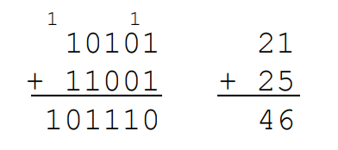
Binary Addition
CSC 111- Introduction To Information & Communication Technologies
• Two n-bit values
– Add individual bits
– Propagate carries
– E.g.,

Slide 37
Binary Multiplication
CSC 111- Introduction To Information & Communication Technologies
Decimal | Binary | Octal
0 | 0 | 0
0 | 1 | 0
1 | 0 | 0
1 | 1 | 1

Slide 38
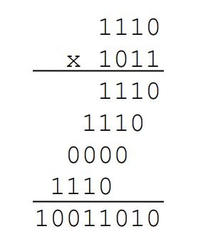
Binary Multiplication
CSC 111- Introduction To Information & Communication Technologies
Binary, two n-bit values
– As with decimal values
– E.g.,

Slide 39
COMPUTER NUMBER SYSTEM
CSC 111- Introduction To Information & Communication Technologies
Besides numerical data, computer must be able to handle alphabets, punctuation marks, mathematical operators, special symbols, etc. that form the complete character set of English language. The complete set of characters or symbols are called alphanumeric codes. The complete alphanumeric code typically includes
26 upper case letters
26 lower case letters
10 digits
punctuation marks
20 to 40 special characters

Slide 40
ASCII
CSC 111- Introduction To Information & Communication Technologies
ASCII, in full American Standard Code for Information Interchange, a standard data-encoding format for electronic communication between computers.
ASCII assigns standard numeric values to letters, numerals, punctuation marks, and other characters used in computers.

Slide 41
ASCII Code
CSC 111- Introduction To Information & Communication Technologies
ASCII was originally developed for basic computers and printers. It uses a 7-bit code to represent characters.
The Standard ASCII Character Set and Codes table given below contains 128 characters with corresponding numerical codes in the range 0..127 (decimal).

Slide 42
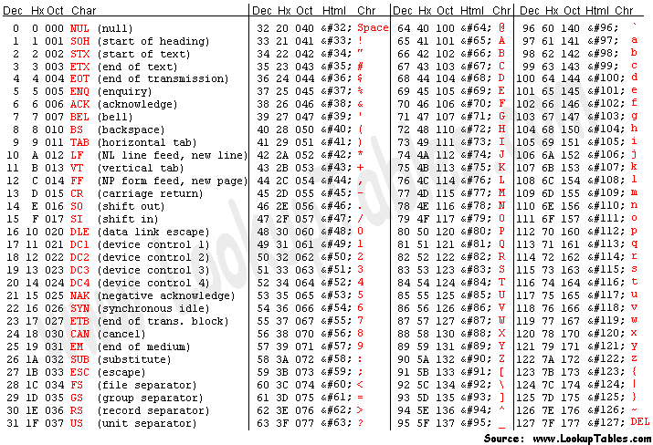
ASCII Code
CSC 111- Introduction To Information & Communication Technologies

Slide 43
COMPUTER NUMBER SYSTEM
CSC 111- Introduction To Information & Communication Technologies
Extended ASCII characters and codes
A set of codes that extends the basic ASCII set. The basic ASCII set uses 7 bits for each character, giving it a total of 128 unique symbols. The extended ASCII character set uses 8 bits, which gives it an additional 128 characters. The extra characters represent characters from foreign languages and special symbols for drawing pictures.

Slide 44
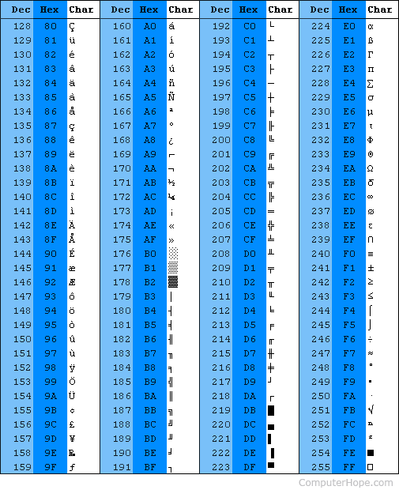
NUMBER SYSTEM
CSC 111- Introduction To Information & Communication Technologies

Slide 45
ASCII
CSC 111- Introduction To Information & Communication Technologies
ASCII sections
The ASCII table is divided into three different sections.
Non-printable, system codes between 0 and 31.
Lower ASCII, between 32 and 127. This table originates from the older American systems, which worked on 7-bit character tables.
Higher ASCII, between 128 and 255. This portion is programmable characters are based on the language of your operating system or program you are using. Foreign letters are also placed in this section.

Slide 46
ASCII
CSC 111- Introduction To Information & Communication Technologies
Limitation of ASCII
The 128 or 256 character limits of ASCII and Extended ASCII limits the number of character sets that can be held.
Representing the character sets for several different language structures is not possible in ASCII, there are just not enough available characters.

